Slide 1
Organizing Meals for a Work Party
Kim Merrick
Former State-wide Work Party Kitchen Leader

Slide 2
How I Got This Way
Whining at a work party
This is WAY more work
A ‘party’ atmosphere brings more participants
"Sure, I’ll help you!”
Taking over

Slide 3
It Was All In Her Head
The sign up
The menu
The equipment
The shopping
The logistics
The actual cooking

Slide 4
Who Is Coming?
Make people sign up!
Cost figuring
Stick to the budget
Leftovers
What you can count on
How many cooks do you need?

Slide 5
What Shall We Eat?
Cook it first!
Sample menus
A serving is not a serving in the woods
Do what you know

Slide 6
What Tools Do We Need?
Burners/ovens
Dishes
Serving
Food storage
Clean up

Slide 7
How Will We Get It There?
How I do it
3 shopping trips
Using the freezer
Label it!

Slide 8
Now that we’re here, who’s doing what?
Let them work
Get a water boy
Get a coffee gal
Set up a dish station
Post menus and meal times

Slide 9
The Book

Slide 10
Sample Crew List
Sat July 21 | Sun July 22 | Mon July 23 | Tues July 24 | Weds July 25 | Thurs July 26
Breakfast crew: Brandi Heather Ranae Mary Pat Kim Cathy Upper | Breakfast Crew: Brandi Heather Ranae Mary Pat Kim Olga | Breakfast Crew: Brandi Heather Ranae Betty Mary Pat Kim | Breakfast Crew: Brandi Beth Ranae Betty Mary Pat Kim | Breakfast Crew: Brandi Beth Ranae Betty Mary Pat Kim | Breakfast Crew: Brandi Beth Ranae Betty Mary Pat Kim
Menu: blueberry pancakes, bacon | Menu: scrambled eggs w/cheese, sausage, hashbrowns | Menu: pancakes, spam | Menu: eggs, bacon, hash browns with peppers and onions | Menu: pancakes, sausage | Menu: breakfast burritos
headcount: 55 | headcount: 76 | headcount: 76 | Headcount: 73 | Headcount: 71 | Headcount: 64
# of lunches 61 | # of lunches 74 | # of lunches 74 | # of lunches 68 | # of lunches 68 | # of lunches 47
July 21 | July 22 | July 23 | July 24 | July 25
Dinner Crew: Marcy Brandi Ranae Betty Mary Pat Kim | Dinner Crew: Marcy Brandi Ranae Betty Mary Pat Kim | Dinner Crew: Marcy Brandi Ranae Betty Mary Pat Kim | Dinner Crew: Marcy Heather Ranae Mary Beth Pat Kim | Dinner Crew: Marcy Heather Ranae Mary Beth Pat Kim
Menu: Taco bar | Menu: Chicken & rice | Menu: Beef bourguignon Mashed potatoes | Menu: Pork tenderloin onion shortcake | Menu: Steak Sinful potatoes
Headcount: 70 | Headcount: 77 | Headcount: 75 | Headcount: 73 | Headcount: 71

Slide 11
Sample Equipment List
Camp Kitchen Equipment list for 75 people
(borrowing more dutch ovens)
3 14” Dutch ovens
4 12” Dutch ovens
5 bags charcoal
1 charcoal starter
1 lid lifter
2 lid stands,
2 stove lighters
1 roll parchment paper
2 rolls heavy duty foil
1 roll sandwich wrap
400 snack baggies
1 can opener
2 peelers
4 paring knives
2 dull crappy knives
2 medium mixing bowls
1 set measuring cups
1 set measuring spoons
4 large serving bowls
2 16 Qt serving bowls
2 serving spoons
2 ladles
2 sets of tongs
2 12 qt containers w/lids
3 large serving trays
2 hot water pots
2 dish racks
50 clothes pins
1 clothesline
6 table cloths
1 jar GOJO soap
1 hand sanitizer
30 dish towels
8 white aprons
1 first aid kit
16-20 ice chests
23 blocks ice
15 bags ice
1 12 inch skillet (eggs only)
1 15 inch cast iron skillet
2 12 quart stock pot (48 serv)
1 16 quart stock pot (64 serv)
1 large saucepan (kim e’s)

Slide 12
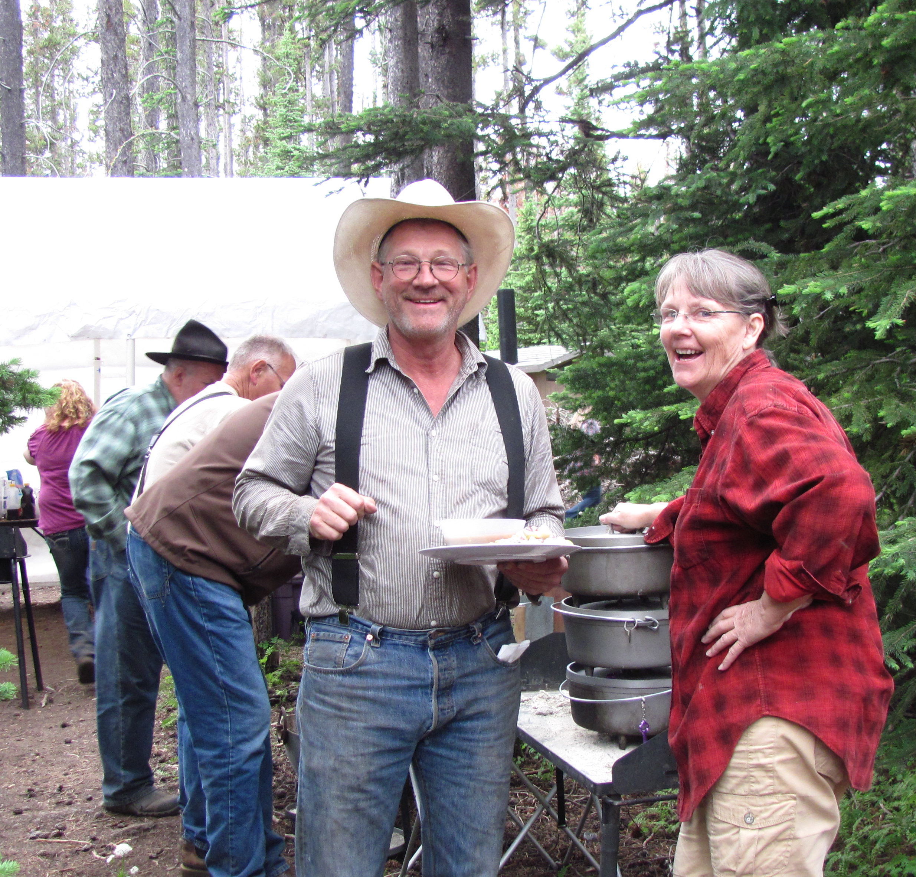
What
Questions
Do You Have?

