Slide 1
US Forest Service
National Saw Program
Pacific Northwest Region 6
Policy Changes

Slide 2
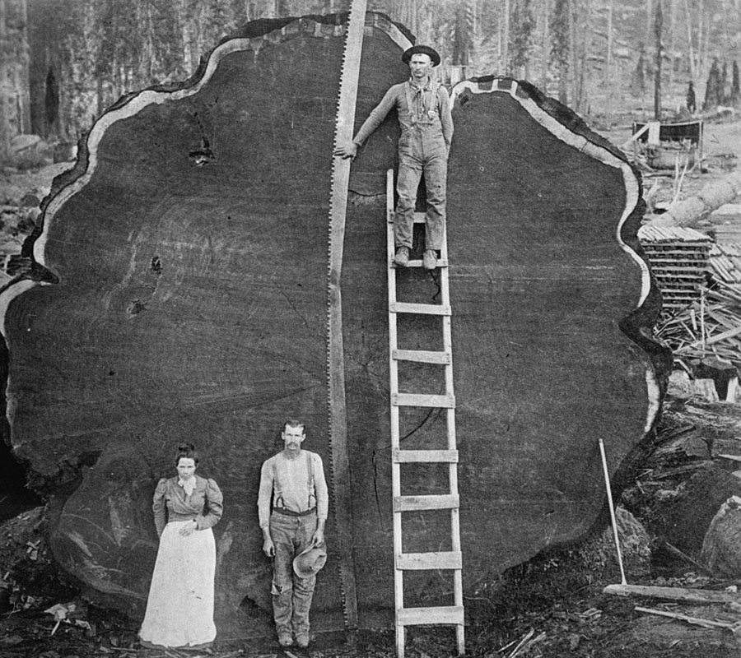
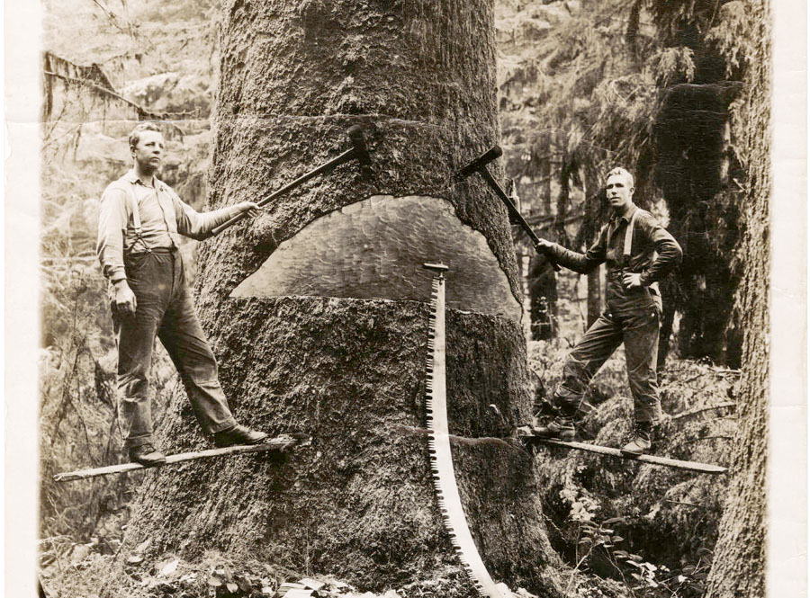
Pacific Northwest
A Loggers Dream
First saw mill erected at Fort Vancouver
in 1828
First shipment of Oregon timber is sent to
China in 1833
By 1900 Great Lakes timber is exhausted and
companies move to the West Coast
1883 to 1940 intensive logging begins
due to technological developments and large
capital investments
USFS created in 1905 to conserve forests for continued use

Slide 3
Region 6 Supplemental
HEALTH AND SAFETY CODE
Work Projects and Activities, 1989
First region to commission an integrated multidisciplinary review of the saw program, Doug Dent (1987-1989)
First region to develop a regional saw policy as a supplement to the Health and Safety Code Handbook
First region to designate and fund a Regional Sawyer Program Manager
Only region to require the use of an outside professional consultant during training and certification of C-Sawyers
First region to develop saw training and certification programs where volunteers can certify their own members

Slide 4

US Forest Service
National Saw Program Policy
National Saw program realigned under recreation (50% Sawyers Recreation / 25% Fire)
Standardization of saw training and certification programs nationwide
All certifications now good for three years, A, B, & C certified sawyers
Certification level no longer based on Diameter (DBH) - complexity is now used
No restrictions on a saw cards – 7 different certification levels
No longer requires the use of a professional training consultant
created
7. Regional Saw Program Managers
8. National Saw Program Manager
9. National Sawyer Certification database

Slide 5

R6 Saw Program Policy
Supplemental Standards
Key Points:
Appointed Regional Sawyer Program Manager
Implemented use of professional consultant during the certification and training of C-Sawyers
Mandated yearly certifications of A and B level sawyers
Mandated biannual certification of C level sawyers
Allowed Forest to be more restrictive
Sawyer certification level based on dbh

Slide 6
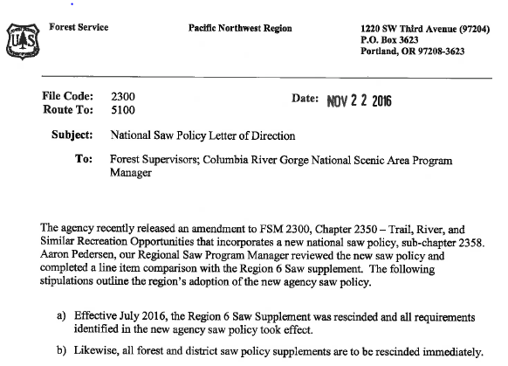
National
Saw Policy
Region 6
Letter of Direction
R6 Saw Supplement
rescinded
All forest / district
saw policies
rescinded

Slide 7
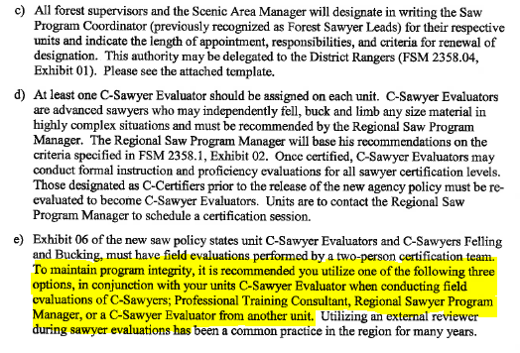
National
Saw Policy
Region 6
Letter of Direction
Designation Letters
Saw Program Coord.
-unit recommendation
d) Designation of
C-Sawyer Evaluators
Program integrity
- Professional
- RSPM
- Evaluator from
another unit

Slide 8

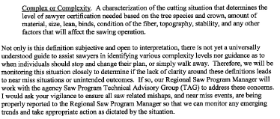
National
Saw Policy
Region 6
Letter of Direction
f) Yearly skills refresher A, B, & C
-COMPLEXITY-

Slide 9
UNDERSTANDING
COMPLEXITY
OHLEC
A 5 step field tool to help identify thresholds within each step of a saw operation

Slide 10
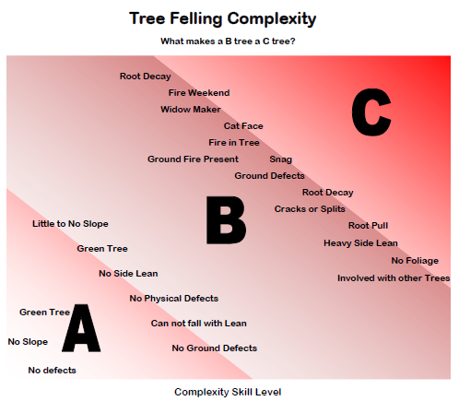

Slide 11

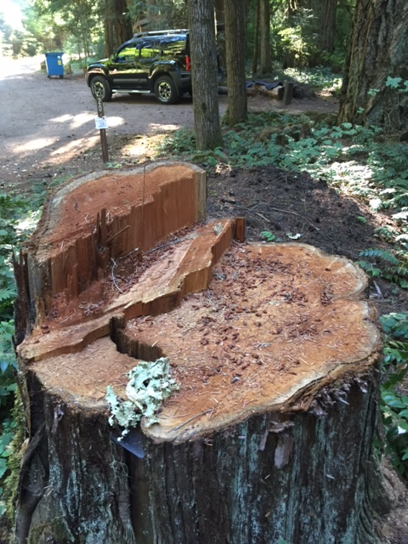
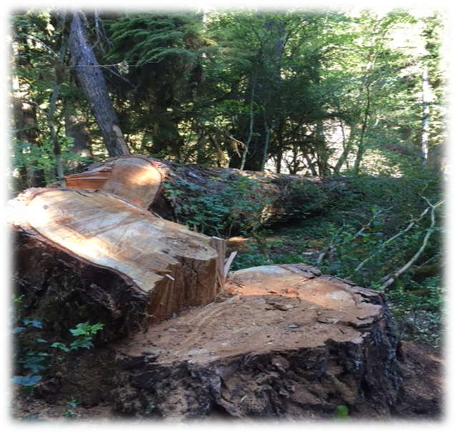
Sawyer Responsibilities and Limitations
Training, Knowledge and Skill Requirements
C Sawyer Evaluator (Minimum)
Formal Instruction 8hrs
Field Proficiency 12hrs
Training 20-36hrs
Prerequisites First Aid/CPR
A Sawyer
B Sawyer Bucking Only
B Sawyer Felling and Bucking
C Sawyer Bucking Only
C Sawyer Felling and Bucking

Slide 12
Grants and Agreements
PROGRAMMATIC PROVISIONS
TRAINING, EVALUATION, AND CERTIFICATION OF SAWYERS
USED BY COOPERATORS.
Any of the cooperator’s employees, and any participants and volunteers engaged on behalf of the cooperator and Forest Service, who will use chain saws or crosscut saws on National Forest System lands to conduct the program of work contained in this agreement must be trained, evaluated, and certified in accordance with Forest Service Manual 2358 and Forest Service Handbook 6709.11, section 22.48b. The cooperator is responsible for providing this training, evaluation, and certification, unless the Forest Service and the cooperator determine it is not in the best interest of the partnership. In these circumstances, the Forest Service, upon request and based on availability of Agency funding and personnel, may assist with developing and conducting training, evaluation, and certification of the cooperator’s employees, and any volunteers and participants engaged on behalf of the cooperator and the Forest Service, who will use chain saws or cross cut saws on National Forest System lands.

Slide 13
Forest Service National Saw Policy
(APPLICABILITY: This provision is mandatory for new collection, challenge cost-share, participating, and stewardship agreements where the cooperator anticipates that its employees or participants and volunteers engaged on behalf of the cooperator and Forest Service will use chain saws or crosscut saws to conduct the program of work contained within the agreement.
Where mandatory, this provision must be inserted in the
agreement and will become effective July 19, 2017.

Slide 14

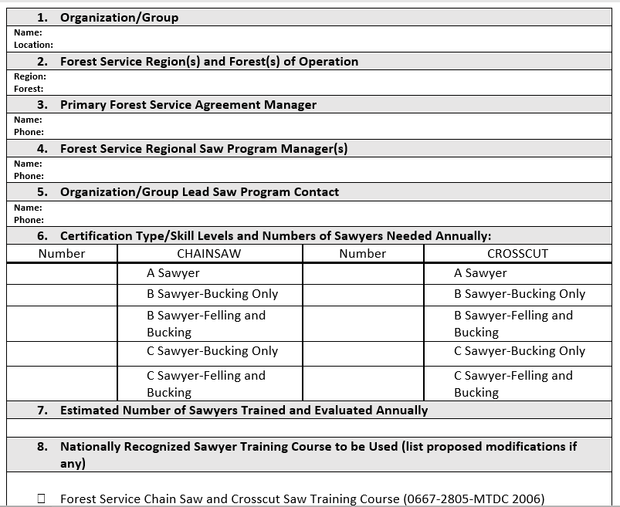

US Forest Service
Cooperator Organizations and Volunteer Groups
Saw Training Program Proposal Submittal Process

Slide 15
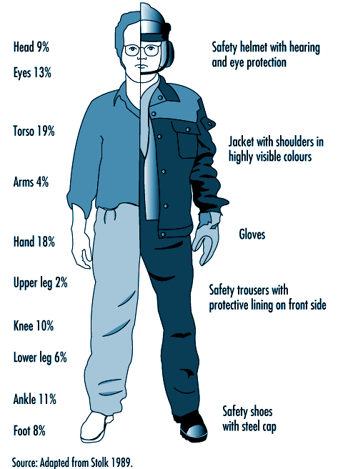

PPE
Changes

Slide 16
PPE
Changes / Updates
FSSOG
PPE | Chain Saw Operations | Crosscut Saw Operations
Hard Hat | Hard hat or cutting helmet meeting ANSI | Same as chain saw
Safety Classes | ANSI1 (clear safety glasses, at a minimum) or equivalent (mesh “bug-eye” type or mesh face shield) | Same as chain saw
Hearing Protection | Hearing protection required for gasoline powered chain saw use | None required
Gloves | Gloves or chain saw mitts are required for all chain saw operations. Leather required for sharpening. Alternative style of gloves may be used for inclement weather conditions, based on JHA | Same as chain saw
Non-fire
Mesh eye protection
Leather gloves required for sharpening only
  (No gloves needed when swinging axe or pulling a crosscut)
Fireline
NFPA standard for hardhat
No mesh face shield
Leather gloves required for all operations

Slide 17
PPE
Changes / Updates
FSSOG
PPE | Chain Saw Operations | Crosscut Saw Operations
Shirt, Pants | Long sleeved shirt and long pants | Long sleeved shirt and long pants
Leg Protection | Chaps or cut-resistant pants for chain saw use shall meet the requirements of Forest Service 6170-4 or ASTM F-1897. Chaps shall overlap boots at least 2” | None required
Non-fire
Long sleeved shirt required for crosscut saw
Cut-resistant pants for chain saw use okay
FS or ASTM certified chaps are both approved
No chaps needed for crosscut
Fireline
Nomex shirt and pants
FS approved chaps only

Slide 18
PPE | Chain Saw Operations | Crosscut Saw Operations
Boots | Cut-resistant or leather, laced 8 inch (204mm) high boots that provide ankle support and nonskid soles (hard toes are optional). OPTIONAL-Use JHA to determine proper footwear for the environment and/or related tasks | Cut- resistant or leather, laced boots that provide ankle support and nonskid soles (hard toes are optional). Use JHA to determine proper footwear for the environment and/or related tasks..
Specialized PPE | Wear additional PPE as identified by local conditions, safety data sheets (SDS), or JHA/RA | Same as chain saw
PPE
Changes / Updates
FSSOG
Non-fire
Boot can be cut-resistant or leather
Optional footwear allowed with JHA and dependent on environment or related task
Fireline
8” leather boots required

Slide 19
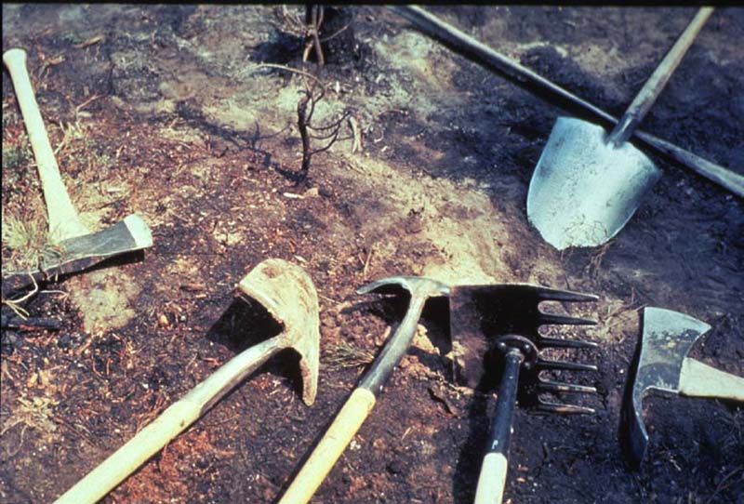
No
Custom Tools
(pounders)
National Saw Policy

Slide 20
Minimum Eligible Sawyer Age
US Department of Labor Requirements
Chain saw sawyers must be at least 18 years of age (29 CFR Part 570, Subpart E)
Crosscut sawyers must be at least 16 years of age.

Slide 21
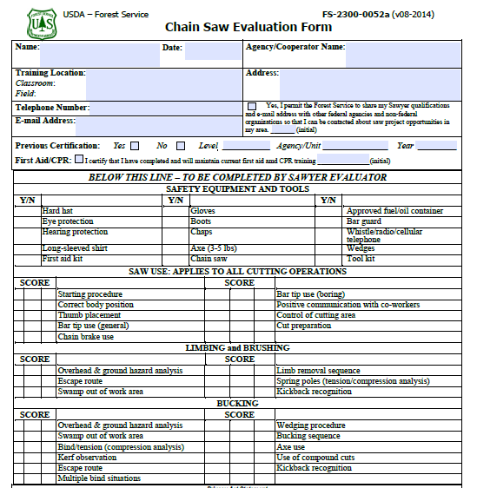
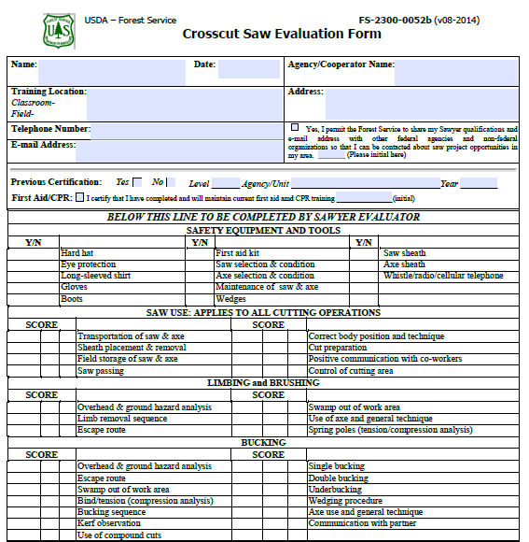
New Evaluation Forms
Note: A scale of 1 through 3 to identify proficiency
1= Needs Work
2= Demonstrates Ability
3= Shows Strength
N/A or 0= Means not evaluated
or Not Applicable

Slide 22



FUEL GEYSERING
14 Fuel igniting incidents reported in the past five years
National Incident Management Organization (NIMO) Team Developing Fuel Geysering Information
Continued testing by numerous laboratories
Stickers for use on chainsaws
Quick fill fueling system

Slide 23
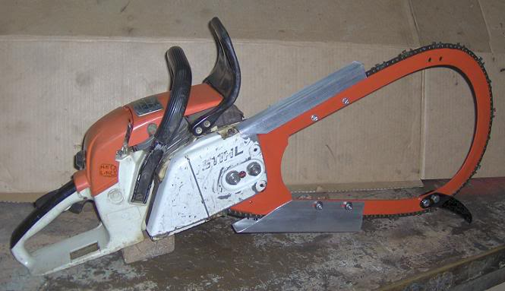
Bow Bars
From S-212 2012
“Bow bars are no longer approved for use on Stihl or Husqvarna chain saws. One of the primary reasons is that the bow bar changes the saw’s center of gravity, preventing the chain brake from engaging properly during kickback. Bow bars should be removed from service.”

Slide 24
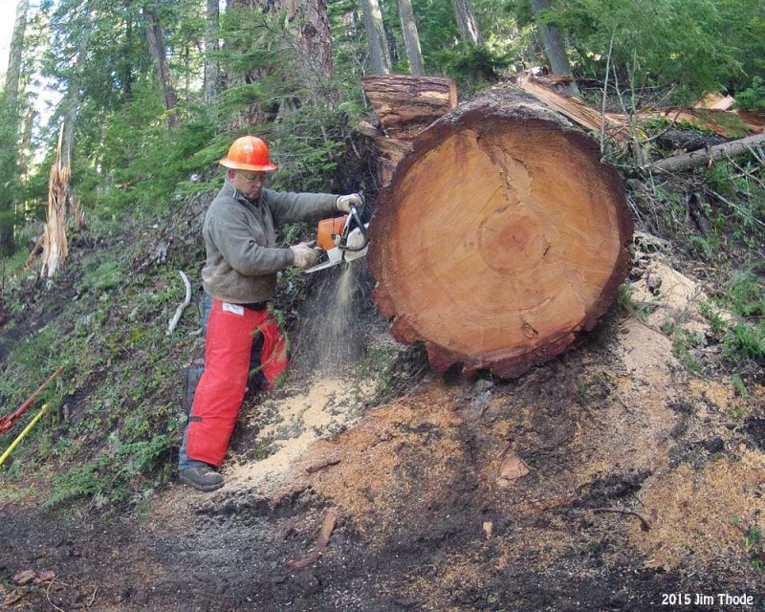
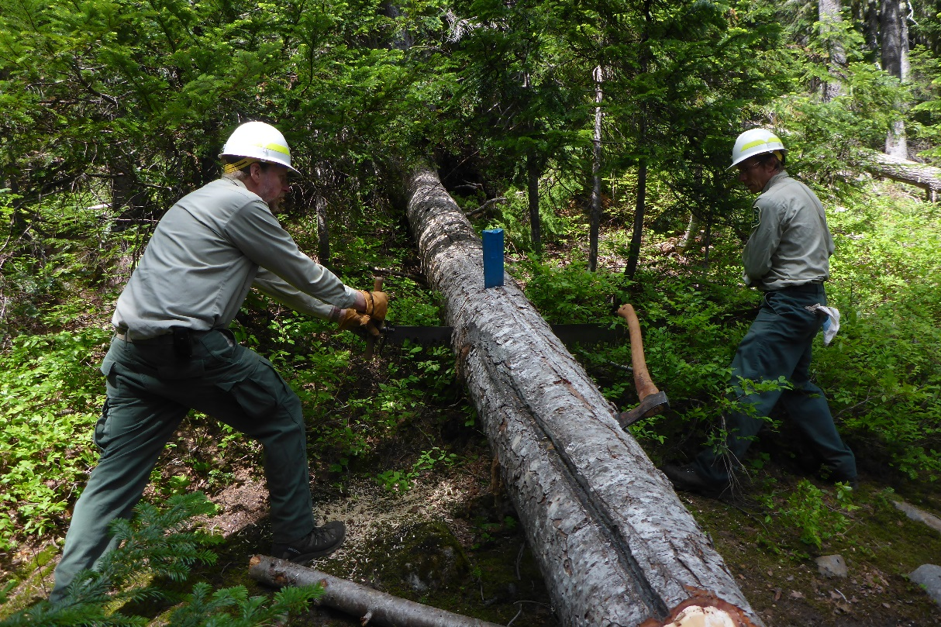
Leading the way in sawyer safety and program management since 1989
Pacific Northwest, Region 6
Sawyer Program
Okanogan-Wenatchee
Debra Davis Lead Forestry Technician, Trails
Tony Karniss
Back Country Horseman
Lead Sawyer Evaluator

Slide 25
Forest Service National Saw Policy
Resources and Information
FSM 2300 Chapter 2350 (Policy)
FSH 6709.11 22.48
USDA Forest Service Saw Operation Guide (FSSOG)
Non-Agency
www.fs.fed.us/about-agency/regulations-policies/saw-policy
National Saw Program Technical Advisory Group (TAG)
SharePoint: https://ems-team.usda.gov/sites/fs-nfs-sptag/SitePages/Splash.aspx

Slide 26

Questions?
National Saw Program

